Slide 1
SINGLE-SOURCE SHORTEST PATHS

Slide 2
Introduction
Generalization of BFS to handle weighted graphs
Direct Graph G = ( V, E ), edge weight fn ; w : E → R
In BFS w(e)=1 for all e in E
Weight of path p = v₁ → v₂ → … → v_{k} is

Slide 3
Shortest Path
Shortest Path = Path of minimum weight
δ(u,v)=
p
min{ω(p) : u v}; if there is a path from u to v,
∞ otherwise.

Slide 4
Shortest-Path Variants
Shortest-Path problems
Single-source shortest-paths problem: Find the shortest path from s to each vertex v. (e.g. BFS)
Single-destination shortest-paths problem: Find a shortest path to a given destination vertex t from each vertex v.
Single-pair shortest-path problem: Find a shortest path from u to v for given vertices u and v.
All-pairs shortest-paths problem: Find a shortest path from u to v for every pair of vertices u and v.

Slide 5
Optimal Substructure Property
Theorem: Subpaths of shortest paths are also shortest paths
Let P_{1k} = <v₁, ... ,v_{k} > be a shortest path from v₁ to v_{k}
Let P_{ij} = <v_{i}, ... ,v_{j} > be subpath of P_{1k} from v_{i} to v_{j}
for any i, j
Then P_{ij} is a shortest path from v_{i} to v_{j}

Slide 6
Optimal Substructure Property
Proof: By cut and paste
If some subpath were not a shortest path
We could substitute a shorter subpath to create a shorter total path
Hence, the original path would not be shortest path
v₀
v₁
v₂
v₃
v₄
v₅
v₆
v₇

Slide 7
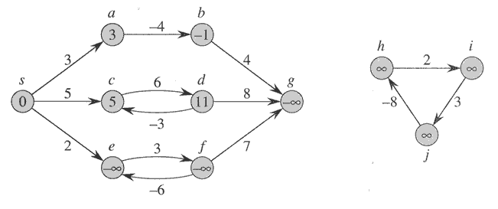
Negative-weight edges
No problem, as long as no negative-weight cycles are reachable from the source
Otherwise, we can just keep going around it, and
get w(s, v) = −∞ for all v on the cycle.

Slide 8
Triangle Inequality
Lemma 1: for a given vertex s in V and for every edge (u,v) in E,
δ(s,v) ≤ δ(s,u) + w(u,v)
Proof: shortest path s v is no longer than any other path.
in particular the path that takes the shortest path s v and
then takes cycle (u,v)
υ
ϖ
σ

Slide 9
Relaxation
Maintain d[v] for each v in V
d[v] is called shortest-path weight estimate
and it is upper bound on δ(s,v)
INIT(G, s)
for each v ∈ V do
d[v] ← ∞
π[v] ← NIL
d[s] ← 0

Slide 10
Relaxation
RELAX(u, v)
if d[v] > d[u]+w(u,v) then
d[v] ← d[u]+w(u,v)
π[v] ← u
u
v
u
v
2
2
5
9
5
6
Relax(u,v)
5
7
5
6
2
2
u
v
u
v

Slide 11
Single-Source Shortest Paths in DAGs (Directed Acyclic Graphs)
Shortest paths are always well-defined in dags
no cycles => no negative-weight cycles even if there are negative-weight edges
Idea: If we were lucky
To process vertices on each shortest path from left to right, we would be done in 1 pass

Slide 12
Single-Source Shortest Paths in DAGs
In a dag:
Every path is a sub-sequence of the topologically sorted vertex order
If we do topological sort and process vertices in that order
We will process each path in forward order
Never relax edges out of a vertex until have processed all edges into the vertex
Thus, just 1 pass is sufficient

Slide 13
Single-Source Shortest Paths in DAGs
DAG-SHORTEST PATHS(G, s)
TOPOLOGICALLY-SORT the vertices of G
INIT(G, s)
for each vertex u taken in topologically sorted order do
for each v in Adj[u] do
RELAX(u, v)

Slide 14
Example
Lets suppose we start from s

Slide 15
Example

Slide 16
Example

Slide 17
Example

Slide 18
Example

Slide 19
Example

Slide 20
Dijkstra’s Algorithm For Shortest Paths
Cycles: Allowed
Negative edge weight: Not Allowed
Like BFS: If all edge weights are equal, then use BFS, otherwise use this algorithm
Use Q = priority queue keyed on d[v] values
(note: BFS uses FIFO)

Slide 21
Dijkstra’s Algorithm For Shortest Paths
DIJKSTRA(G, s)
INIT(G, s)
S←Ø > set of discovered nodes
Q←V[G]
while Q ≠Ø do
u←EXTRACT-MIN(Q)
S←S U {u}
for each v in Adj[u] do
RELAX(u, v) > May cause
> DECREASE-KEY(Q, v, d[v])

Slide 22
EXAMPLE 1

Slide 23
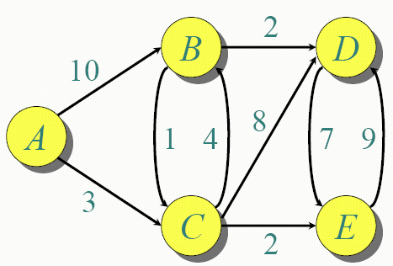

Slide 24
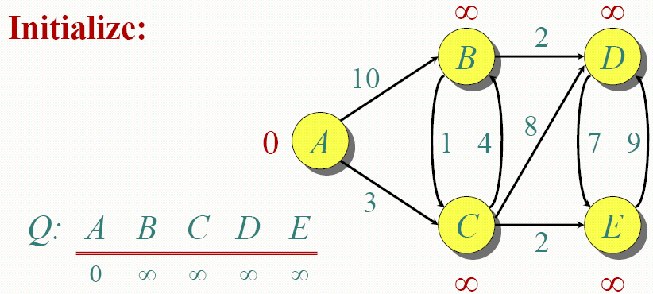
S : {}

Slide 25
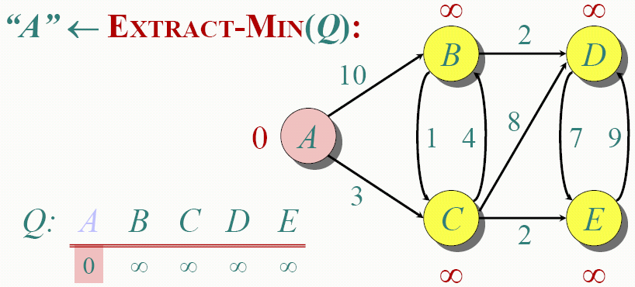
S : {A}

Slide 26
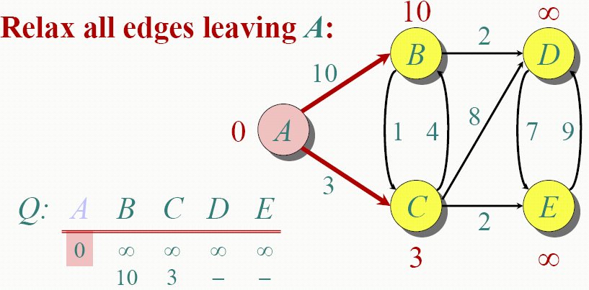
S : {A}

Slide 27
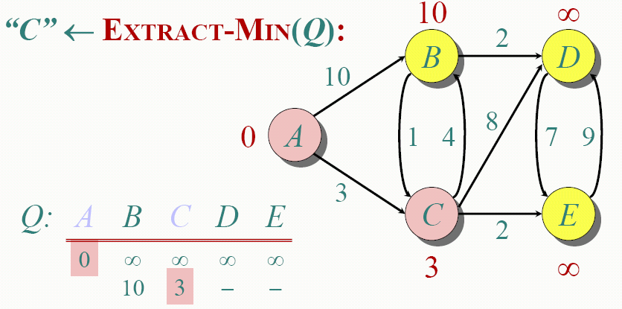
S : {A,C}

Slide 28
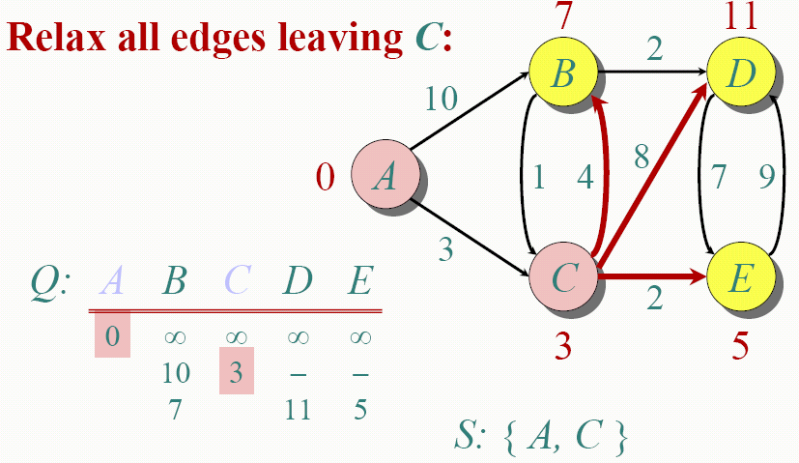

Slide 29
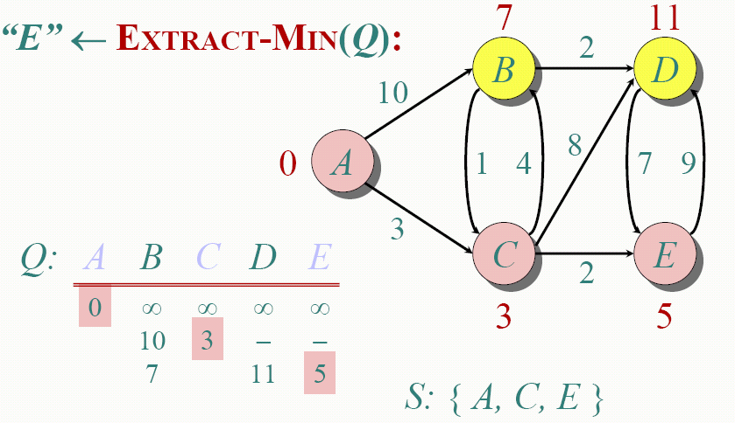

Slide 30
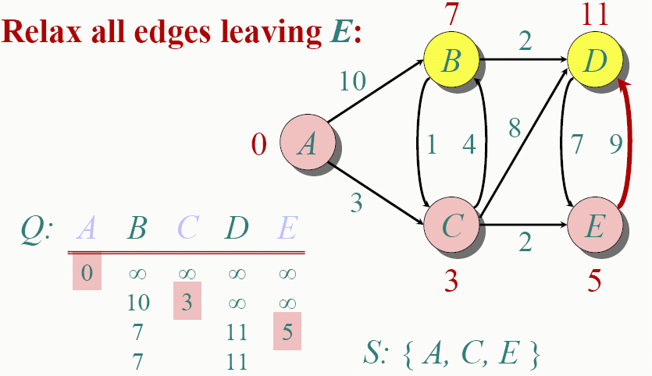

Slide 31
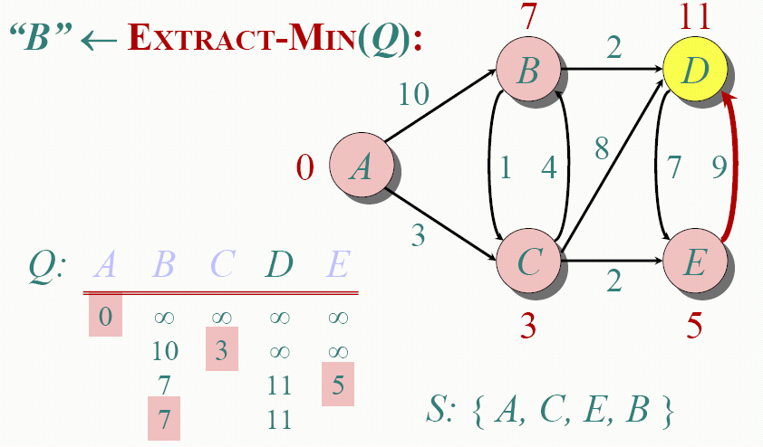

Slide 32
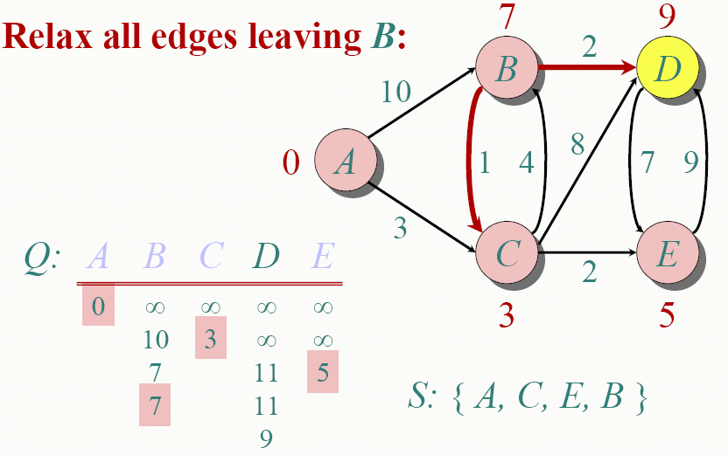

Slide 33
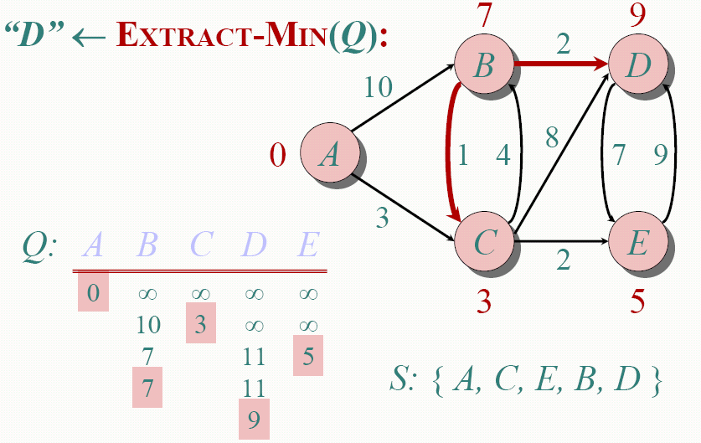

Slide 34
EXAMPLE 2

Slide 35
Example
u
v
∞
1
∞
10
0
2
3
9
s
4
6
7
5
∞
∞
2
x
y

Slide 36
Example
u
v
10
1
∞
10
9
0
2
3
s
4
6
7
5
5
∞
2
x
y

Slide 37
Example
u
v
8
1
14
10
0
2
3
9
s
4
6
7
5
5
7
2
x
y

Slide 38
Example
u
v
8
1
13
10
2
3
9
s
0
4
6
7
5
5
7
2
x
y

Slide 39
Example
u
v
8
1
9
10
0
2
3
9
s
4
6
7
5
5
7
2
x
y

Slide 40
Example
u
v
8
1
9
10
2
3
9
0
4
6
s
7
5
5
7
2
x
y

Slide 41
Bellman-Ford Algorithm for Single Source Shortest Paths
More general than Dijkstra’s algorithm:
Edge-weights can be negative
Detects the existence of negative-weight cycle(s) reachable from s.

Slide 42
Bellman-Ford Algorithm for Single Source Shortest Paths
BELMAN-FORD( G, s )
INIT( G, s )
for i ←1 to |V|-1 do
for each edge (u, v) ∈ E do
RELAX( u, v )
for each edge ( u, v ) ∈ E do
if d[v] > d[u]+w(u,v) then
return FALSE > neg-weight cycle
return TRUE

Slide 43
Bellman-Ford Algorithm for Single Source Shortest Paths
Observe:
First nested for-loop performs |V|-1 relaxation passes; relax every edge at each pass
Last for-loop checks the existence of a negative-weight cycle reachable from s

Slide 44
EXAMPLE 1

Slide 45
Bellman-Ford Algorithm Example
t
5
x
-2
6
∞
∞
-3
s
0
8
-4
7
2
7
∞
∞
9
y
z

Slide 46
Bellman-Ford Algorithm Example
t
5
x
6
-2
∞
6
-3
s
0
8
-4
7
2
7
7
∞
9
y
z

Slide 47
Bellman-Ford Algorithm Example
t
5
x
-2
6
6
4
-3
s
0
8
-4
7
2
7
7
2
9
y
z

Slide 48
Bellman-Ford Algorithm Example
t
5
x
-2
6
2
4
-3
s
0
8
-4
7
2
7
7
2
9
y
z

Slide 49
Bellman-Ford Algorithm Example
t
5
x
-2
6
2
4
-3
s
0
8
-4
7
2
7
7
−2
9
y
z

Slide 50
Bellman-Ford Algorithm Example
Now check for the negative cycle condition:
for each edge ( u, v ) ∈ E
if d[v] > d[u]+w(u,v) then
t
5
x
Negative cycle found!
-2
6
2
4
-3
s
0
8
-4
7
2
7
7
−2
9
y
z
NO NEGATIVE CYCLE IN THIS EXAMPLE

Slide 51
EXAMPLE 2

Slide 52
0
∞
2
1
2
-2
1
1
3
4
3
∞
∞

Slide 53
0
∞
2
1
2
-2
1
1
3
4
3
1
∞

Slide 54
0
-1
2
1
2
-2
1
1
3
4
3
1
3

Slide 55
0
-1
2
1
2
-2
1
1
3
4
3
1
0

Slide 56
0
-1
2
1
2
-2
1
1
3
4
3
1
0

